Slide 1
School Leader’s Literacy Walkthrough for Grades K-5
Notes:
Good Morning and Welcome Everyone!
Today’s presentation is about how to Utilize the School Leader’s Literacy Walkthrough tool for Grades K-5.

Slide 2
Session Goals
Introduction
Provide the purpose of the walkthrough tool and overview its development.
Overview
Overview the components of the walkthrough tool including the introduction and research section, pre-walkthrough meeting guide, the checklists, and the post-walkthrough meeting guide.
Practice
Practice using the components of the walkthrough.
Discuss
Examine some sample data and discuss the implications of the walkthrough data.
Notes:
SAY: During this session we will be working to accomplish the goals on the screen. We will first review the purpose of the tool and describe its development, then we’ll provide an overview of the components of the tool, we’ll provide you with some time to practice using the walkthrough, and we’ll also examine some sample data and discuss how we might use it to improve literacy instruction.

Slide 3
Purpose of the Walkthrough Tool
The School Leader’s Literacy Walkthrough tool is designed to assist school leaders in supporting classroom literacy instruction and is aligned to Florida’s B.E.S.T. English Language Arts Standards.
For the purposes of this tool, school leaders may include principals, assistant principals, literacy coaches, members of the literacy leadership team, teacher leaders or others.
This tool is not meant to be used in the evaluation of teachers. Instead, this tool is intended to help school leaders enhance literacy instruction knowledge, establish lines of communication centered on literacy instruction with teachers, and ensure consistent language regarding literacy content and instructional practices.
Further, the use of this tool can be the foundation for productive conversations among school leaders and teachers to inform coaching and professional learning needs to improve instruction. Teachers should be given a copy of the walkthrough tool and school leaders should provide an overview of the tool and its purpose.
Notes:
Notes: Review the bullets on the slide

Slide 4
Development of the Walkthrough Tool
Using a walkthrough tool created by the Regional Educational Laboratory (REL) Southeast as a template, the Florida Center for Reading Research created a grades K-5 walkthrough aligned to the B.E.S.T. ELA standards and benchmarks.
An overview document was created to guide school leaders in the use of the tool, individual checklists were developed for each grade level, and brief pre- and post-walkthrough check-ins were developed.
The walkthrough tool was reviewed extensively by the Florida Department of Education and approved during the spring of 2022.
Notes:
Notes: Review the bullets on the slide

Slide 5
Components of the Walkthrough Tool
Pre-Walkthrough
Walkthrough Checklists
Post-Walkthrough
Overview Document
Notes:
SAY: Here are the components of the walkthrough tool. We’ll provide briefly review them, and then we’ll delve more deeply into the checklists.

Slide 6
Overview Document
Provides an introduction to the tool highlighting its purpose
Provides an overview of the three sections of the tool
Explains how the tool can be used
Includes the core components of the Florida Practice Profile
Includes the pre- and post-walkthrough check-ins, school leader reflection questions, and a template for action planning
Notes:
SAY: The overview document provides information that can guide the school leader in the use of the tool.

Slide 7
Using the Walkthrough Tool
The school leader meets with the teacher and completes the brief pre-walkthrough check-in
The school leader chooses the appropriate walkthrough checklist and conducts a brief (5-15 minute) classroom walkthrough, completing the sections of the checklist that align to the lesson
The school leader completes the brief reflection section of the post-walkthrough meeting check-in and completes the remainder of the guide with the teacher
Notes:
SAY: This is the process that school leaders would use the walkthrough tool. Remember that the tool is designed to conduct brief, frequent walkthroughs so that school leaders can get a sense of the state of literacy instruction in their buildings. Decisions regarding the allocation of coaching and other resources as well as the provision of professional learning opportunities may be made using the data collected with the walkthrough tool. It is important that teachers know you will be conducting these walkthroughs, the purpose for which they are being conducted, and that they have the opportunity to review the walkthrough tool if they wish to do so.

Slide 8
Using the Tool
This tool can be used for frequent 5 to15-minute walkthroughs. It may be used to focus on either one literacy component (e.g., Foundations) or multiple literacy components (e.g., Communication and Vocabulary). The school leader should not expect to see every benchmark and strand during a walkthrough; however, benchmarks should be combined purposefully and may cross strands.
A school leader may also plan to observe a specific literacy component (e.g., Vocabulary; Phonics and Word Analysis). The school leader should discuss this with the teacher during the pre-walkthrough check-in so the timing of the walkthrough will coincide with that component of instruction.
Space is provided for school leaders to record evidence in the form of notes and reflections. These comments are essential to the effective use of this tool and will help guide the post-walkthrough reflection with the teacher. In addition, school leaders will use the check boxes in the instructional delivery column to note effective or ineffective explicit, systematic, and/or differentiated instruction as well as scaffolding and corrective feedback. These practices are aligned with the Florida Practice Profile.
The walkthrough is not meant to be evaluative and this should be emphasized with teachers.
Notes:
Notes: Review the information on the slide.

Slide 9
Core Components of the Florida Practice Profile
Explicit Instruction
Systematic Instruction
Scaffolded Instruction
Corrective Feedback
Differentiated Instruction
Notes:
Notes: Review the information on the slide.
SAY: These are the core components of the Florida Practice Profile – information concerning each of these is contained in the overview document of the Grades K-5 walkthrough.

Slide 10
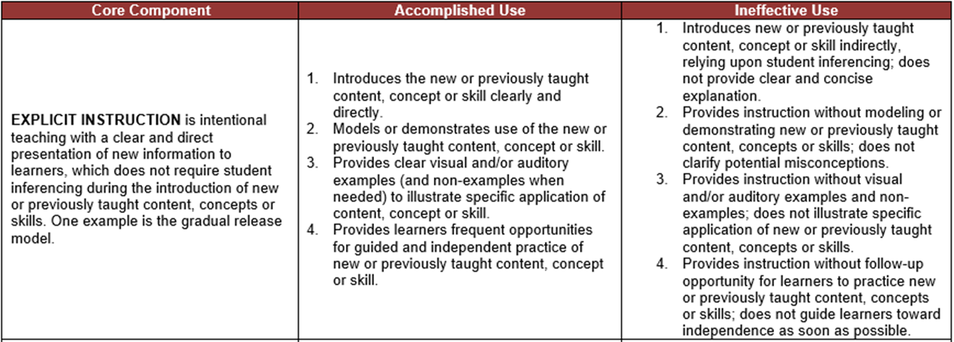
Sample Component
Notes:
SAY: In the overview document there is information like this to remind school leaders of the definition of each component in the practice profile and what accomplished use and ineffective use looks like. School leaders can review this information as a reminder of what to look for before they enter classrooms.

Slide 11
Pre-Walkthrough Check-In
The purpose of this guide is to facilitate a brief conversation between the school leader who will conduct the walkthrough and the teacher. The goal is for the school leader to gain an understanding of the focus of the lesson they will see during the walkthrough. The teacher will also have an opportunity to request that the school leader to look for specific components of instruction to help improve instruction.
Notes:
Notes: Review the information on the slide.

Slide 12
Pre-Walkthrough Check-In
Notes:
SAY: This is a screenshot of the pre-walkthrough check-in that is included in the overview document included with the K-5 walkthrough. You will note that it is very brief. Remember, this walkthrough is not designed to be evaluative, so the check-in is simply to get an idea of what the content of the lesson will be during the walkthrough and to schedule a time

Slide 13
Post-Walkthrough Reflection
This guide provides reflection questions for the school leader, and questions to discuss with the teacher after the walkthrough. Additional questions may be added to guide a collaborative conversation with the teacher. Lastly, if needed, an action plan can be completed with the teacher.
Notes:
Notes: Review the information on the slide

Slide 14
Post Walkthrough Reflection
Notes:
SAY: These questions just provide some questions for you to reflect upon before you meet with the teacher. There may be others that you think of that aren’t here, but we thought these would help you prepare for the brief conversation with the teacher after the walkthrough.

Slide 15
Reflection and Action Planning
Notes:
SAY: This screenshot shows the three discussion questions for the school leader and teacher. Again, the meeting is meant to be brief. The school leader and teacher can develop an action plan if they think it’s necessary, and indicate when there should be follow-up either in the form of another conversation or another walkthrough.

Slide 16
Checklists
The grade-specific checklists for grades K-5 contain sections that focus on each B.E.S.T. literacy strand (i.e., Foundations, Reading, Communication, and Vocabulary) and the benchmarks.
The school leader should use the appropriate grade level and section to take notes regarding instruction and student learning during the walkthrough.
The school leader may indicate if they see effective or ineffective explicit instruction, systematic instruction, differentiation, scaffolding, and corrective feedback provided by the teacher. As an alternative, the school leader may choose to leave this column blank and use it to reflect with the teacher regarding instruction
The school leader may also indicate the level of student cognitive engagement in their learning.
Notes:
SAY: Now that we’ve reviewed the overview document, let’s take a look at the checklists that are provided as a part of the tool.
Notes: Review the information on the slide

Slide 17
Notes:
SAY: This is a screenshot of the first page of the first grade walkthrough checklist. You see that there are four sections of the checklist. The standards and benchmarks are reflected in each of these sections. The school leader should identify the focus of instruction prior to the walkthrough so they can choose the appropriate section(s) to use.

Slide 18
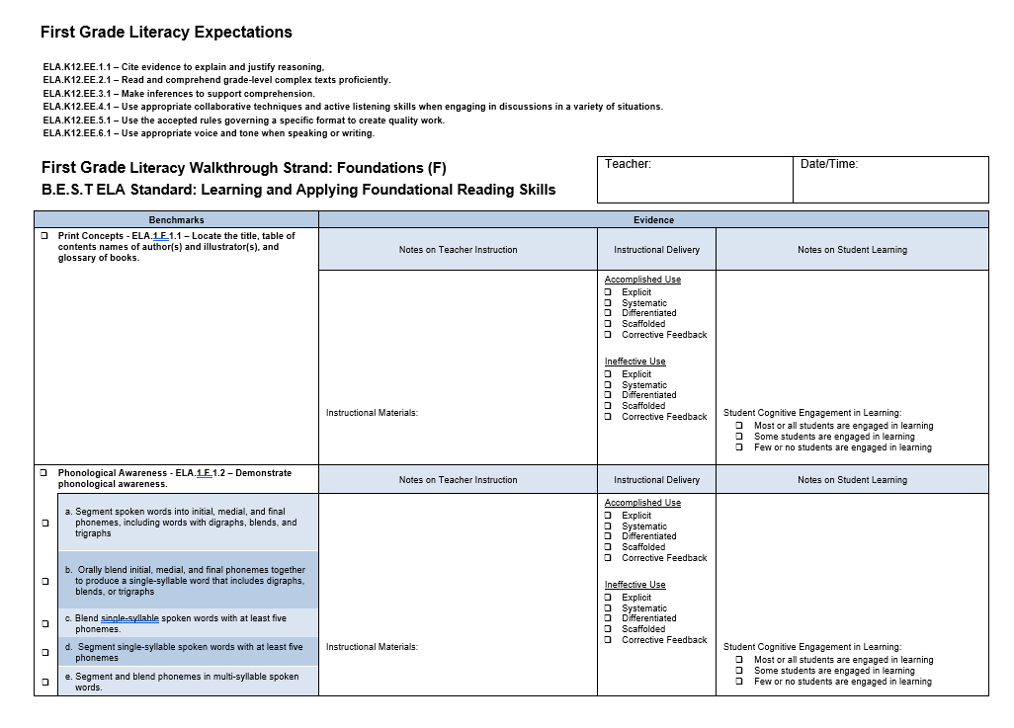
Example of the First Grade Checklist
Notes:
SAY: This is the first page of the Foundations checklist for first grade. The standards and benchmarks are listed on the left, and the school leader can check the ones that are addressed during the classroom. There is also a place for notes regarding the teacher instruction, a place to delineate the materials being used and a column to enter notes about student learning. There are also checkboxes to reflect student engagement. The column regarding instructional delivery contains checkboxes that reflect effective or ineffective use of the practice profile components. Those that are not seen are left blank. The school leader may check these boxes, or if this feels too evaluative, the leader and teacher may complete this column together when they have their post-walkthrough check-in meeting.

Slide 19
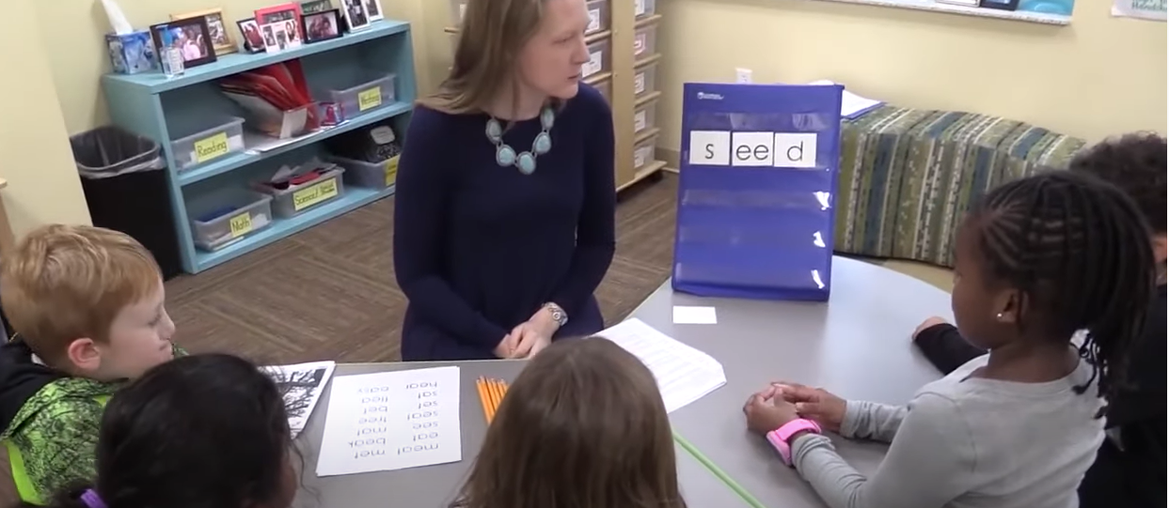
Practice Using the Tool
Decoding, Writing, and Recognizing Words
Notes:
Notes: This video is 7 minutes. You can watch some or all of it. If you choose to watch only a portion, you may want to watch it twice – once to get a sense of the lesson, and the second time to complete the walkthrough checklist. If you wish to watch the entire video, you may have participants simply watch for the first two-three minutes, and then complete the checklist. After participants complete the walkthrough, they should discuss what they recorded with their small group and then be ready to debrief with the whole group.
SAY: This video addresses ELA.1.F.1.3: Use knowledge of grade-appropriate phonics and word-analysis skills to decode words accurately. f. Decode words that use final –e and vowel teams to make long-vowel sound. After you complete the walkthrough checklist, discuss your thoughts at your table and then we’ll debrief with the whole group.

Slide 20
Notes:
SAY: This is a screenshot of the first page of the third grade walkthrough checklist. You see that there are four sections of the checklist, just like the one for first grade. The standards and benchmarks are reflected in each of these sections. The school leader should identify the focus of instruction prior to the walkthrough so they can choose the appropriate section(s) to use.

Slide 21
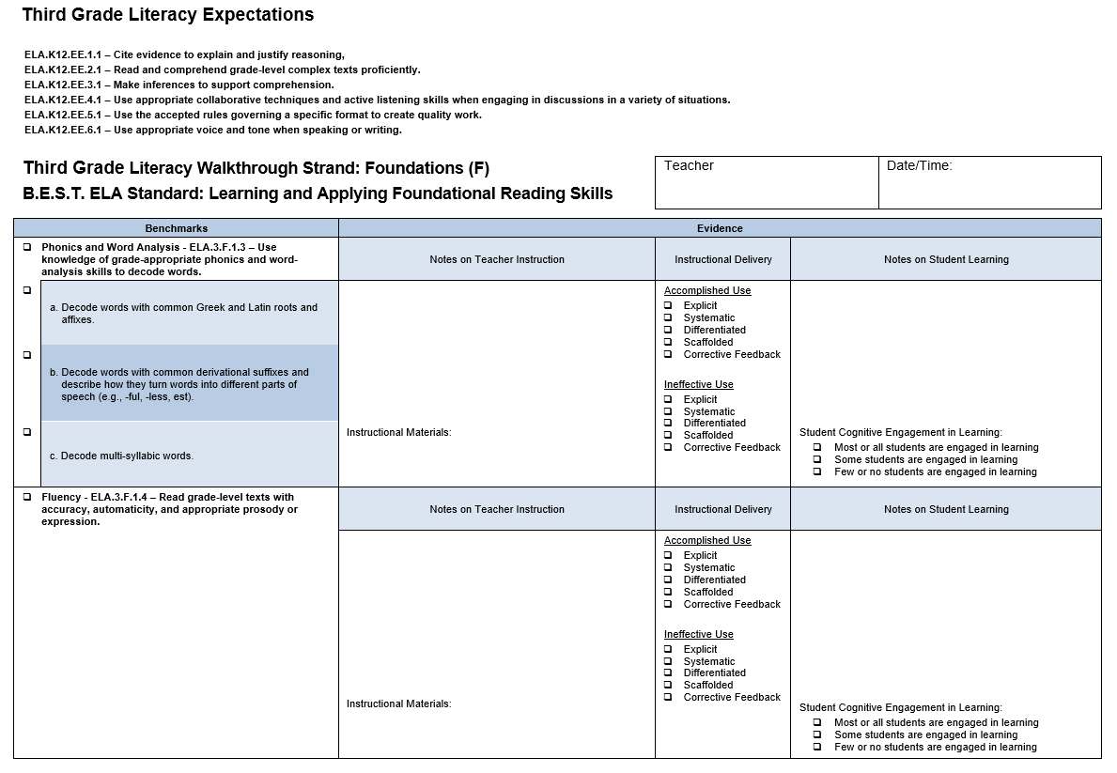
Notes:
Notes: The format is the same for every checklist. You don’t have to say everything below…
SAY: This is the first page of the Foundations checklist for third grade. The standards and benchmarks are listed on the left, and the school leader can check the ones that are addressed during the classroom. There is also a place for notes regarding the teacher instruction, a place to delineate the materials being used and a column to enter notes about student learning. There are also checkboxes to reflect student engagement. The column regarding instructional delivery contains checkboxes that reflect effective or ineffective use of the practice profile components. Those that are not seen are left blank. The school leader may check these boxes, or if this feels too evaluative, the leader and teacher may complete this column together when they have their post-walkthrough check-in meeting.

Slide 22
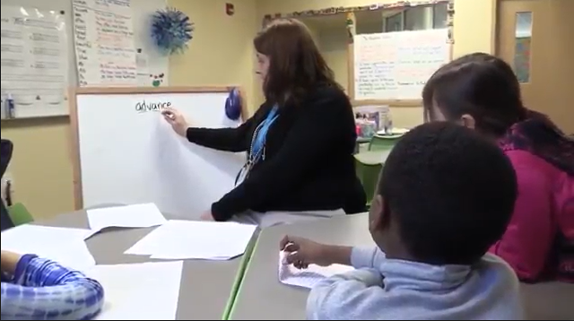
Practice Using the Tool
Choral Reading
Notes:
Notes: This video addresses the foundational skill of fluency and decoding multi-syllabic words.. The video is only a couple of minutes long –play it once to get a sense of the lesson and then play it again.
SAY: You’ll need the grade three checklist for foundations – we’ll be looking at fluency and decoding multi-syllabic words. These ELA.3.F.1.4 – Read grade-level texts with accuracy, automaticity, and appropriate prosody or expression and Phonics and Word Analysis - ELA.3.F.1.3 – Use knowledge of grade-appropriate phonics and word-analysis skills to decode words c. decode multi-syllabic words. This video is very short. We’ll watch it first to get a sense of the lesson and again to complete the walkthrough checklist. After you complete the checklist, discuss what you recorded on the checklist with your small group. Be ready to share out in our whole group in just a few minutes.

Slide 23
Analyzing the Walkthrough Data
What are the strengths and needs for professional development do you see in individual teachers’ instruction across time?
What are the strengths and needs for professional development do you see in instruction at each grade level across time?
What strengths and needs for professional development do you see schoolwide across time?
Notes:
Notes: Review the information on the screen
SAY: We’ve reflected that this walkthrough is not meant to be evaluative – and what we mean by that is it should not be used as a formal evaluation for teachers. In essence, you are capturing quick snapshots over time of what literacy instruction looks like in your school. Therefore, while the data should not be used to evaluate any specific teacher, it can give you a sense of the overall status of literacy instruction in your school, and help you evaluate next steps to move teachers and students forward. Gathering walkthrough data over time can help you make decisions regarding how to allocate resources, the kinds of professional development opportunities that may need to be provided, and where coaching efforts may be best spent. Looking for trends in data at the teacher level, grade level, and school level, and then making wise decisions based on what you see, may help improve literacy instruction in your building which may move you closer to your goals for student achievement in literacy.

Slide 24
Let’s Practice – Making Data-driven Decisions
Here’s the scenario:
You’ve established the goal of increasing the vocabulary of students in your elementary school and have been conducting walkthroughs of your grade 2 classrooms during time teachers would be providing instruction in vocabulary.
Ms. Jones is a second grade teacher, and this is her first year of teaching.
You and Ms. Jones met for a pre-walkthrough check-in before each walkthrough so the expectation that vocabulary instruction would be occurring was established
After the first walkthrough, you met with Ms. Jones for a post-walkthrough check-in. You decided together she would conduct a similar lesson in two weeks and incorporate some suggestions you provided, especially related to classroom management and student engagement.
Ms. Jones used books about bees for both of her lessons
The first lesson was conducted on September 3 and the next lesson was conducted on September 17th.
Notes:
Notes: This activity will probably take about 15 minutes
SAY: This activity was designed to give you a sense of the process of looking at data from multiple walkthroughs to make decisions. We are going to spend a few minutes looking at walkthrough data from Ms. Jones classroom. At this point, we just have data from two walkthroughs. Although you would have data from walkthroughs of for other teachers, for this activity we’ll focus on the two walkthroughs from Ms. Jones classroom. Let’s review the scenario (review the scenario on the screen).

Slide 25
Let’s Practice – Making Data-driven Decisions
Review the checklist data for Ms. Jones from both of your walkthroughs.
Talk in your small groups
What improvement do you see from one walkthrough to the next?
What was strong in each of the walkthroughs?
What would be the main focus of your post-walkthrough check-in after the second walkthrough?
What kinds of professional learning opportunities or coaching would you provide for Ms. Jones? Why?
Let’s debrief with our whole group
Notes:
Notes: This is a continuation of the activity begun on the previous slide and will probably take about 15 minutes. Be sure to remind the whole group that the intent is to have data from multiple teachers and multiple walkthroughs.
SAY: We’ve provided the walkthrough notes on the vocabulary lesson that Ms. Jones conducted on each of the two dates in September. You just have the vocabulary checklist because that was the focus of the lesson. Take about five minutes and review the data from each of the two walkthroughs. After you have done that spend a few minutes discussing the questions on the screen with your small groups. We understand that you have limited information, that you didn’t actually see this teacher, and that answering some of the questions may be challenging. Don’t overthink – just remember this is an opportunity to practice.

Slide 26
Recap of the Walkthrough Process
Ensure all teachers are informed about the tool and its purpose
Select a grade-level or classroom
Determine the focus of the walkthrough with the teacher using the Pre-Walkthrough Check-In
Conduct the Walkthrough
Conduct the Post-Walkthrough Check-In
Assimilate data over time and use it in to improve literacy instruction in the school
Notes:
Notes: Review the information on the slide.

Slide 27
Session Goals
Introduction
Provide the purpose of the walkthrough tool and overview its development.
Overview
Overview the components of the walkthrough tool including the introduction and research section, pre-walkthrough meeting guide, the checklists, and the post-walkthrough meeting guide.
Practice
Practice using the components of the walkthrough.
Discuss
Examine some sample data and discuss the implications of the walkthrough data.
Notes:
SAY: During this session we addressed the goals on the screen. We reviewed the purpose of the tool and described its development, provided an overview of the components of the tool, engaged in practice using the checklists. We also examined some sample data and discussed how we might use it to improve literacy instruction in our school buildings. We hope that you will consider using this tool to help you get a “big picture” view of literacy instruction in your schools, and that the data you collect will help you and your teachers improve instruction, and ultimately student learning.

Slide 28
Questions???

Slide 29
Contact Information
Dr. Julie Baisden
jbaisden@fsu.edu
Dr. Jennie Gans
jgans@fcrr.org
Dr. Laurie Lee
Llee@fcrr.org

